Slide 1
Enhancing Test Automation with AI Agents
Akshatha Dusa
Sr Test Lead

Slide 2
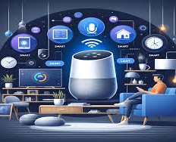
AI in Daily Life

Slide 3
Agenda
AI Agents?
Features of AI agents and more about it .
Agentic AI confused?
How they differ from Traditional test automation
Test Automation Framework + Browser Use +AI Agent +Playwright
Zero Step library + Playwright

Slide 4
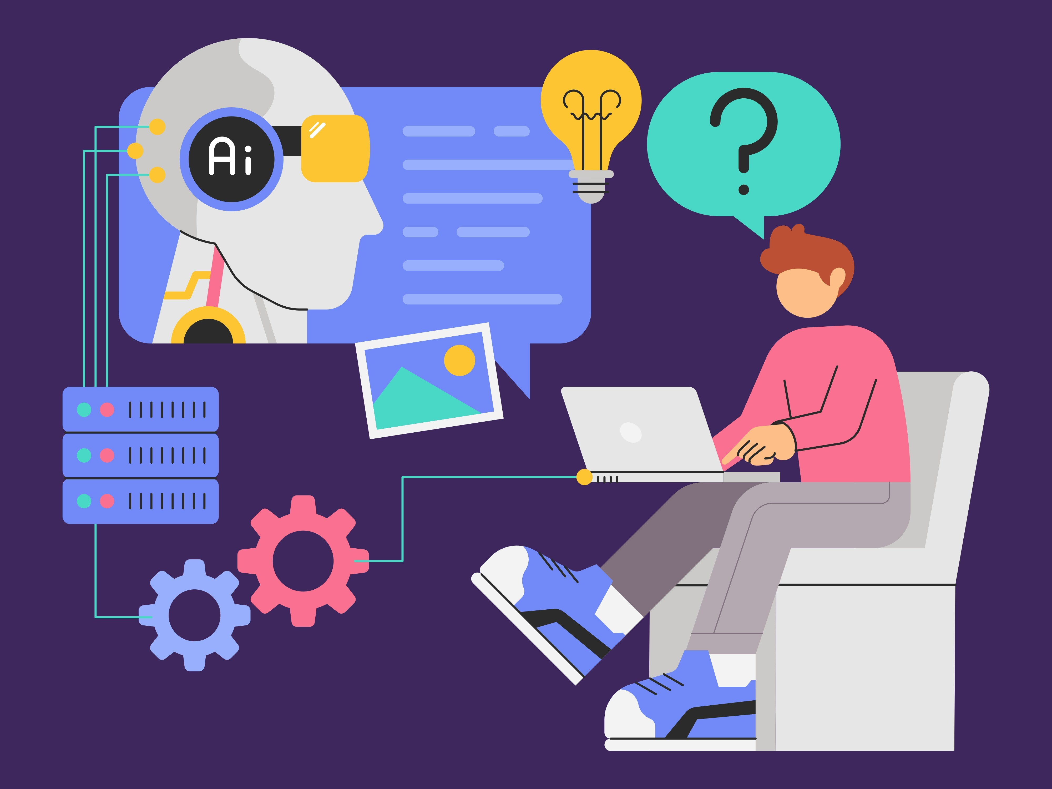
AI Agents? AI agents are autonomous systems that can perceive data, analyze, and make decisions to achieve specific goals.

Slide 5
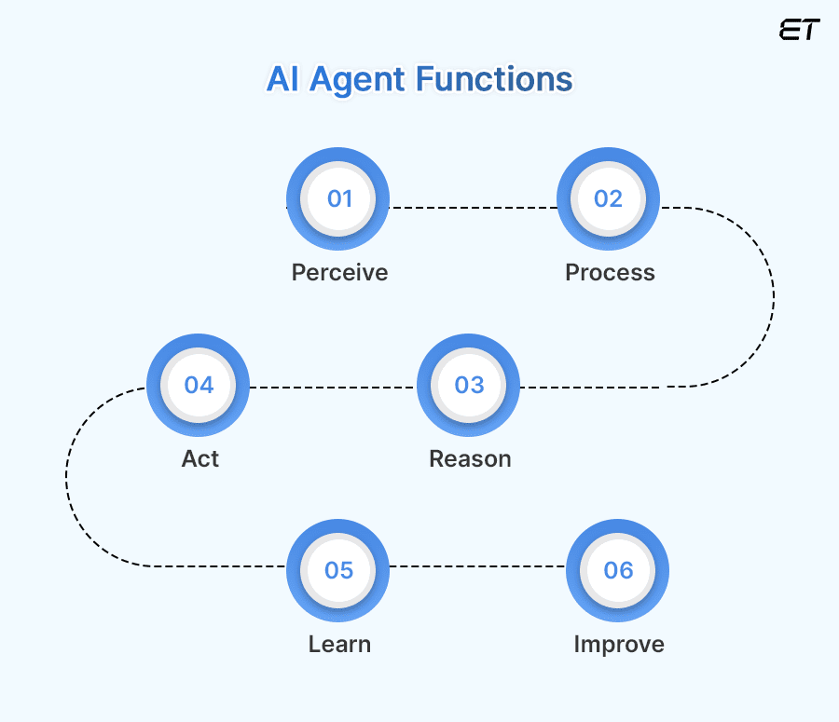
Features

Slide 6
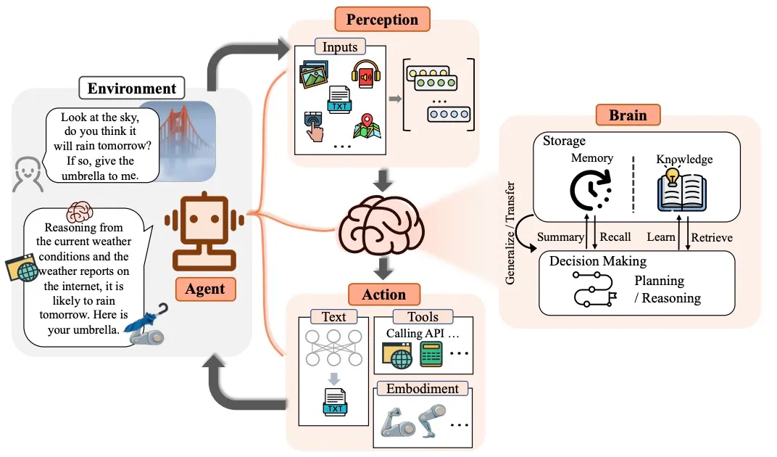

Slide 7
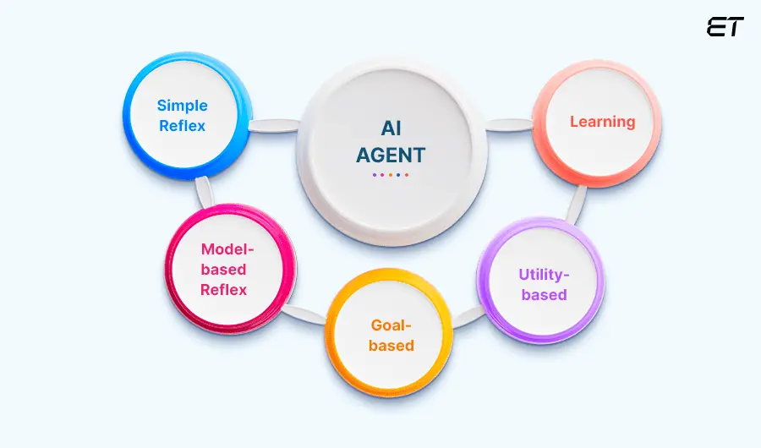
Types

Slide 8
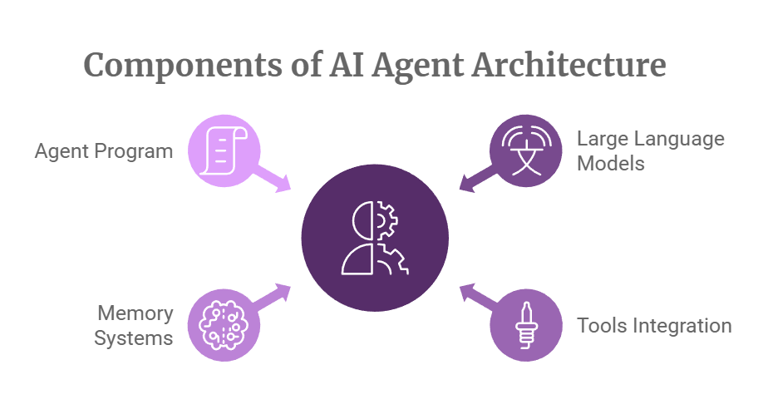

Slide 9
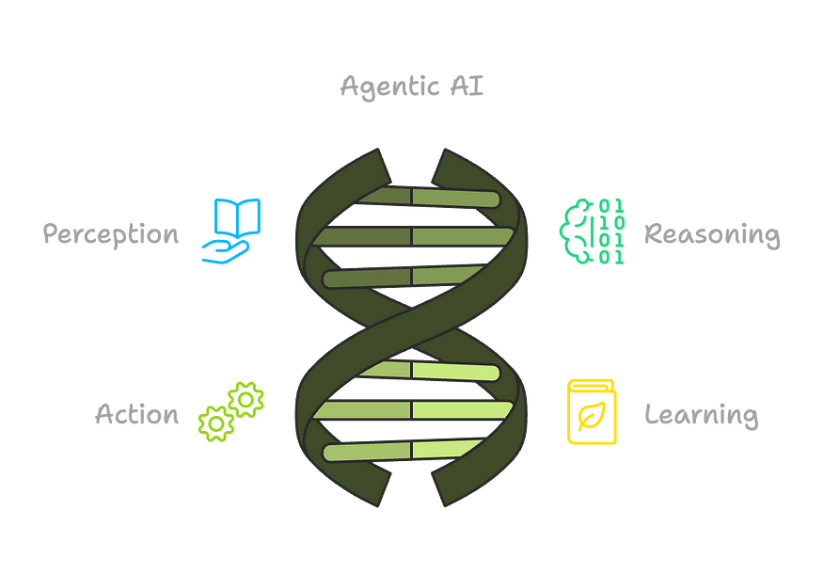
Agentic AI confused?
Agentic AI is a type of AI that’s all about autonomy. This means that it can make decisions, take actions, and even learn on its own to achieve specific goals. It’s kind of like having a virtual assistant that can think, reason, and adapt to changing circumstances without needing constant direction.

Slide 10
AI Agent Use cases
E-Commerce
Personalized Recommendations
Order Automation and Customer Support
Healthcare
Diagnosis Assistance
Patient Monitoring
Finance
Fraud Detection
Algorithmic Trading

Slide 11
How does it now relate to testing
If AI was a QA team member, what skills should it have?”
What’s your biggest challenge in test automation?"

Slide 12
How they differ from Traditional test automation
Feature | Traditional Automation | AI Agents
Test Execution | Rule-based scripts | Dynamic decision-making
Maintenance | High effort | Self-healing
Adaptability | Hardcoded locators | AI-driven smart locators
Intelligence | No learning ability | Learns & improves

Slide 13
Benefits of AI Agents in Testing
Reduce test maintenance with self-healing automation
Increase test stability by adapting to UI changes
Optimize test execution with AI-driven decisions
Improve coverage & efficiency using AI-based test creation

Slide 14
Tools with AI capabilities
Testrigor-Trial Paid
ChatGPT Operator--Paid
Browserbase
BrowserUse --Opensource

Slide 15
Browser use Demo
Design Test automation using AI agent -Playwright
Framework connect your AI agents with the browser.
Plain English code less
Raw automation we need Assertions,validations, locators
Wrappers on top of AI agents
https://github.com/browser-use/browser-use
https://github.com/browser-use/web-ui

Slide 16
Steps
Install Python latest version
Install pycharm editor community
Install Playwright
Create project ->install packages
browser-use ai----to connect to ai agent
pydantic –for asserting the result
langchain-openai
google-ai-generativelanguage
API key using google studio

Slide 17
Integrating AI capabilities to Playwright
Zerostep
Install the @zerostep/playwright dependency
npx playwright test --ui

Slide 18
References
https://www.labellerr.com/blog/what-are-ai-agents-a-comprehensive-guide/
https://browser-use.com/
https://zerostep.com/
https://www.udemy.com/course/generative-ai-in-software-testing/learn/lecture/48713677#overview

